Slide 2
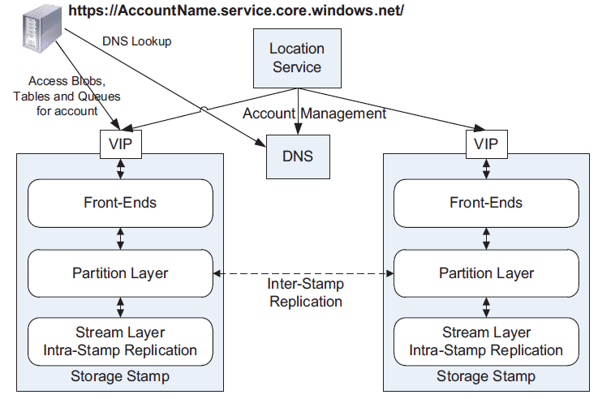
Windows Azure Storage Stamps

Slide 3
Partition Layer
The Partition layer provides:
Data models for types of objects (Blob, Table, Queue)
Logic to process these types of objects
Namespace for the objects
Load balancing
Transaction ordering and strong consistency

Slide 4
Partition Layer
Data model: Object Table (OT) – Account Table, Blob Table, Entity Table, Message Table
OTs are broken into RangePartitions and spread across Partition Servers
Partition Map Table keeps track of RangePartitions and Partition Servers
Load balancing: reassign, split, merge Range Partitions

Slide 5
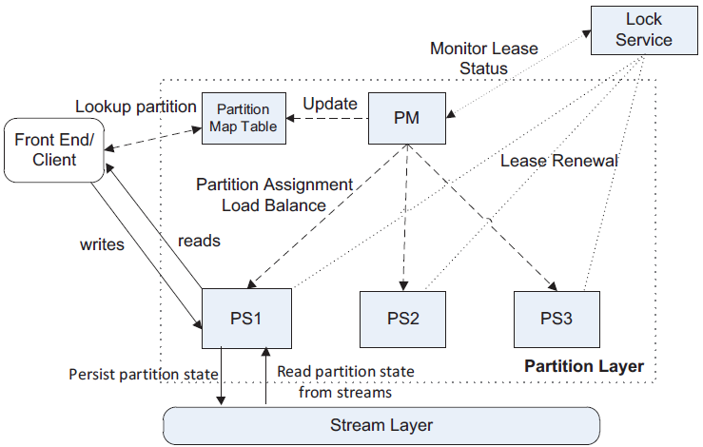
Partition Layer

Slide 6
Partition Layer – Index Range Partitioning
Split index into RangePartitions based on load
Split at PartitionKey boundaries
PartitionMap tracks Index RangePartition assignment to partition servers
Front-End caches the PartitionMap to route user requests
Each part of the index is assigned to only one Partition Server at a time
Blob Index
Account Name | Container Name | Blob Name
aaaa | aaaa | aaaaa
…….. | …….. | ……..
…….. | …….. | ……..
…….. | …….. | ……..
…….. | …….. | ……..
…….. | …….. | ……..
…….. | …….. | ……..
…….. | …….. | ……..
…….. | …….. | ……..
…….. | …….. | ……..
…….. | …….. | ……..
…….. | …….. | ……..
zzzz | zzzz | zzzzz
Account Name | Container Name | Blob Name
aaaa | aaaa | aaaaa
……… | ……… | ………
……… | ……… | ………
harry | pictures | sunrise
Storage Stamp
A-H: PS1
H’-R: PS2
R’-Z: PS3
Partition Master
Partition
Server
Partition Map
Account Name | Container Name | Blob Name
harry | pictures | sunset
……… | ……… | ………
……… | ……… | ………
richard | videos | soccer
A-H
Front-End
Server
PS 1
A-H: PS1
H’-R: PS2
R’-Z: PS3
Partition
Server
Partition
Server
Account Name | Container Name | Blob Name
richard | videos | tennis
……… | ……… | ………
……… | ……… | ………
zzzz | zzzz | zzzzz
R’-Z
H’-R
PS 2
PS 3
Partition
Map

